Slide 1
Topic: Finance EQ: How do we calculate Depreciation?
Year 10 Mathematics

Slide 2
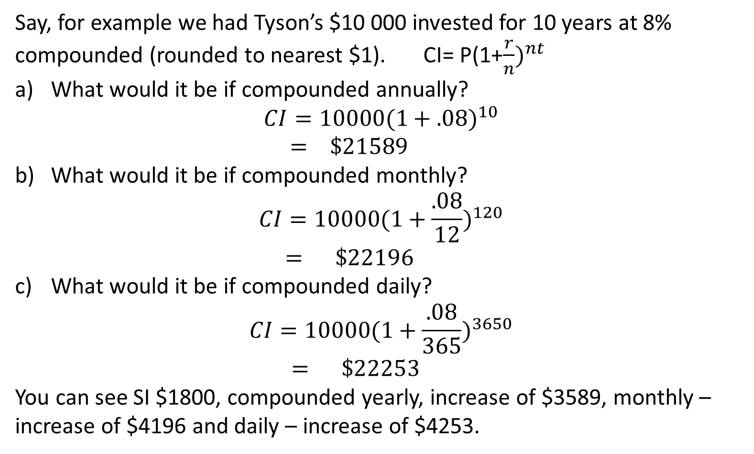
24
7
30
Topic: Finance
Date:
EQ: What happens if we don’t go over a multiple of a full year?
Say, for example we had Tyson’s $10 000 invested for 10 years at 8% compounded (rounded to nearest $1). CI= P(1+$\frac{r}{n})^{nt}$
What would it be if compounded annually? $CI=10000{(1+.08)}^{10}$ $= \$21589$
What would it be if compounded monthly? $CI=10000{(1+\frac{.08}{12})}^{120}$ $= \$22196$
What would it be if compounded daily? $CI=10000{(1+\frac{.08}{365})}^{3650}$ $= \$22253$
You can see SI $1800, compounded yearly, increase of $3589, monthly – increase of $4196 and daily – increase of $4253.
What about 1 month?
What about 1 day?
Compounded 120 times, 12 times a year for 10 years
Compounded 3650 times, 365 times a year for 10 years
Just for interest simple interest would have given $18000.
Notes:
If students don’t know where to begin, give them a clue that they need to use Order of Operations to link the numbers on the vertices to the number inside the triangle.

Slide 3
24
7
30
Topic: Finance
Date:
EQ: How do we calculate depreciation?
Depreciation means an item reduces in value from the time that it is bought.
The original price of an item is called the purchase price of the item. The decrease in value of an item is called the depreciation.
What is depreciation?
How do we calculate depreciation?
We can use the compound interest formula to calculate depreciation of items like cars and some electronic devices.
Notes:
If students don’t know where to begin, give them a clue that they need to use Order of Operations to link the numbers on the vertices to the number inside the triangle.

Slide 4
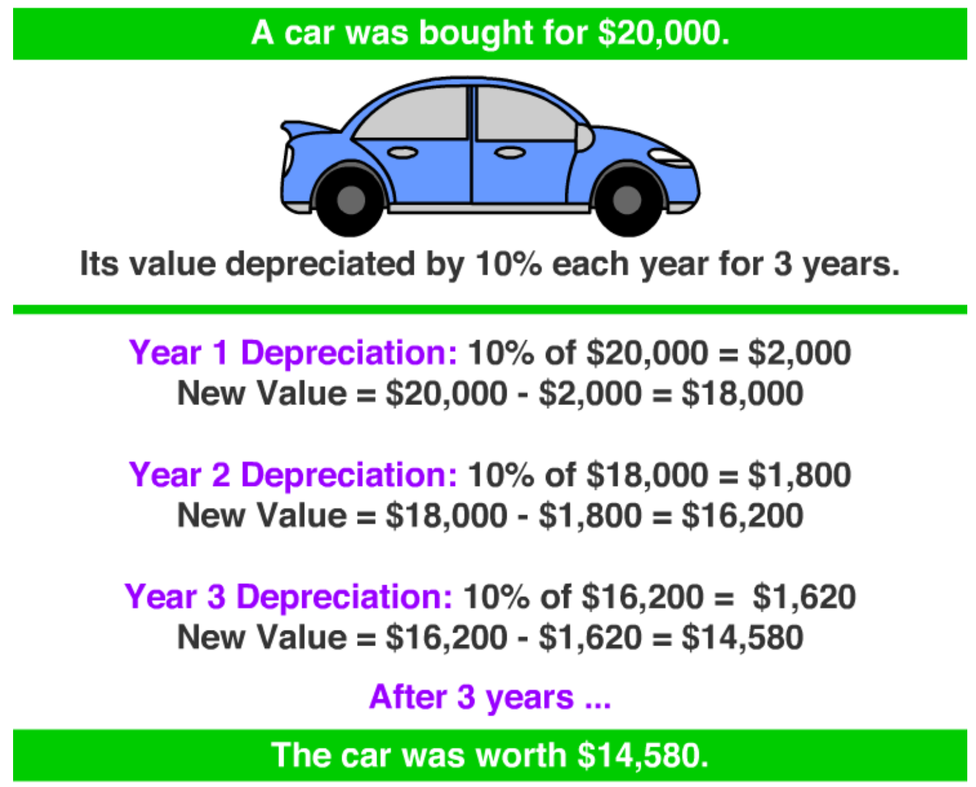

An Example: Depreciation Calculation Per Year

Slide 5
An Example: Depreciation Calculation With Compound Interest Formula

Slide 6
Task
A particular car has a new value of $28 000. If we assume that there is a constant depreciation rate of 7%, what will the value of this car be when it is:
a) 2 years old
b) 8 years old

Slide 7
Task
A particular car has a new value of $42 000. If we assume that there is a constant depreciation rate of 8.5%, what will the value of this car be when it is:
a) 2 years old
b) 10 years old

Slide 8
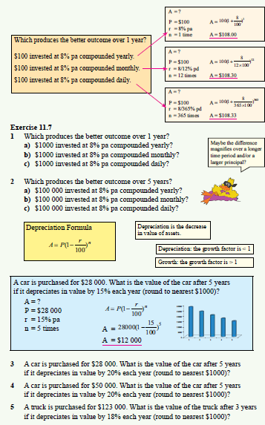
Dywer Year 10 Text Exercise 11.7 Page 320

